Slide 1

Can Twitter Predict Box Office Success?
Dream Reapers
Jason Chong
Shilpa Khanolkar
Justin Le
Matt Yee

Slide 2


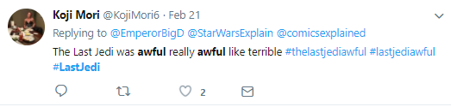
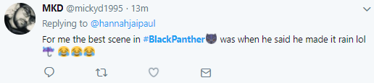


Can Twitter Predict Box Office Success?
Objective
Twitter connects people to friends, businesses, politics, sports and entertainment. With over 200 billion tweets a year, can we find insights to help us predict success in the film industry?
Our analysis will summarize twitter sentiment through Python Vader analysis for over 100 movies released since 2017 which will be used to predict the success of upcoming movies

Slide 3
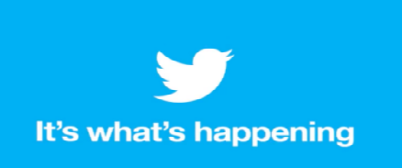



Can Twitter Predict Box Office Success?
Data Sources
Methodology & Program Criteria
Final film qualification: Minimum $10 million budget and tweet count of 10 or higher
For this analysis opening box office gross sales were used to remove longevity biases
Twitter search by movie title hashtag
Analytical tools
Python Vader sentiment analysis
Python z-score and regression analysis
What is success?
Success score created based on multiple factors from opening revenue, budget and ratings
Notes:
From the Number, we pulled the top one hundred movies by opening weekend revenue for the past 12 months. We imported the opening revenue, the domestic total revenue, the worldwide total revenue, the opening budget, the genre and the release date for each movie. There were some hang-ups in this process. Not every movie listed a budget, so we would need to go into a Movie API to find remaining budgets. Additionally, some movies had typos that had to be fixed manually before we could run the movie through the API.

Slide 4
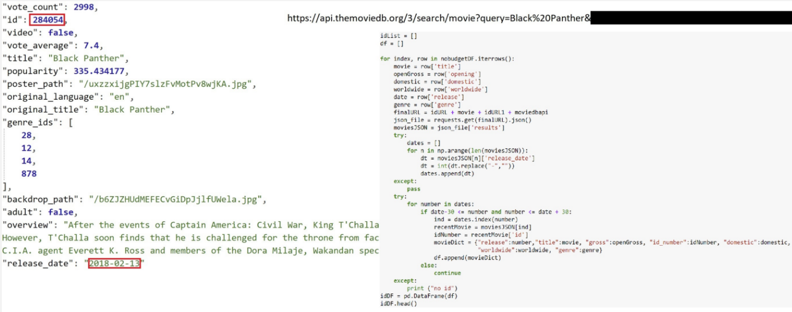
Code: Grabbing Movie Data
Notes:
Using TheMovieDB API, we queried each movie. We had a release date from our raw CSV file, so we matched the release date in the movie (within the month, if there were multiple matches to the movie query search. Once we identified the correct movie, we grabbed the movie id from TheMovieDB to use in the next step…

Slide 5
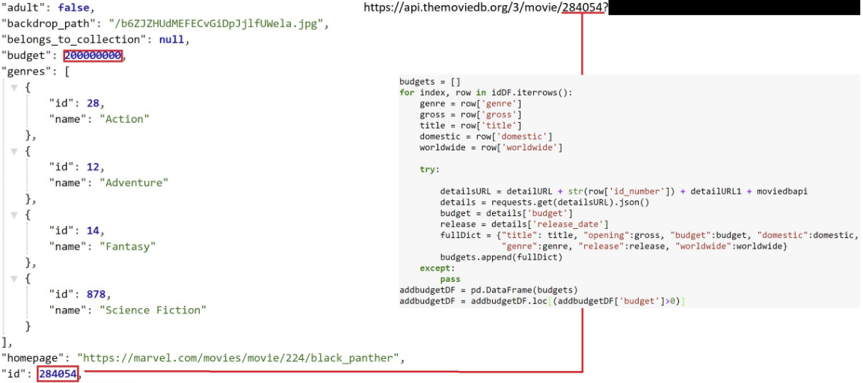
Code: Grabbing Movie Data
Notes:
From the last step, we pulled movie ID number on TheMovieDB. We use the Movie ID number and plug it into a different query. Within this query, we are able to fill in the remaining budgets, if TheMovieDB has it listed, there was an error, we skipped that entry all together. Next, we filtered out the entries so that only movies that had listed budgets remained.

Slide 6
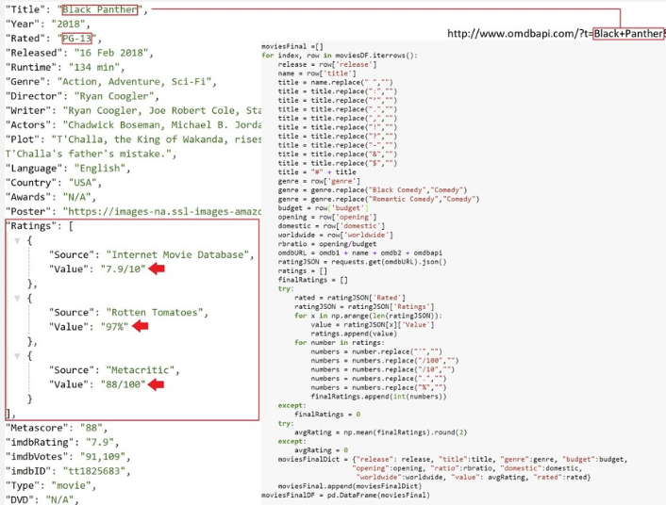
Code: Grabbing Movie Data
Notes:
Next, we needed a few things from the OMDB Api. On the OMDB Api, we grabbed what the movie was rated (G, PG, PG13 or R) as well as the grade that it has received on IMDB, Rotten Tomatoes and Metacritic, if applicable. The Scores were converted to be out of 100 and then the average of scores became the total grade received for a given movie.

Slide 7
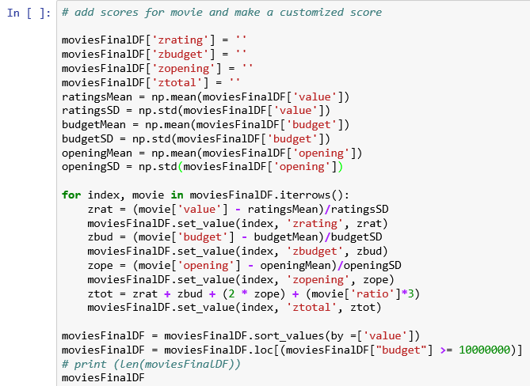
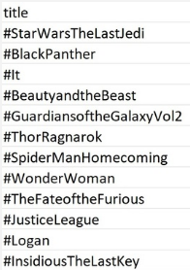
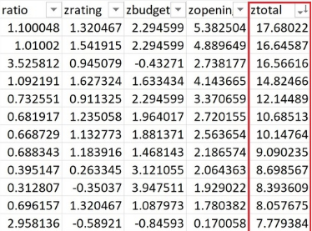
Code: Creating Success Score
Notes:
Now that we have everything we need, we normalized our budget, rating, opening weekend revenue as well as defined a ratio of opening weekend revenue to total budget. We did this to come up with our “movie success score”. For each movie, we added the z-score for the rating, with the z-score for the budget, with double the z-score of the opening weekend revenue, with triple the revenue to budget ratio.
We doubled the opening weekend revenue because at the end of the day, most people grade success of a movie by how many tickets it sold. We looked strictly at opening weekend revenue here as well because we wanted to eliminate biases that may exist due to some movies being in theaters longer and having more time to accrue revenue than others.
We also triple the revenue to budget ratio because some movies may have smaller budget, but may have done very well with respect to that budget in their opening weekend. To use, making up a majority of cost in one weekend also makes a movie successful.
Lastly, we used the rating, because some movies are critically acclaimed but may not sell a lot of tickets in the box office.

Slide 8
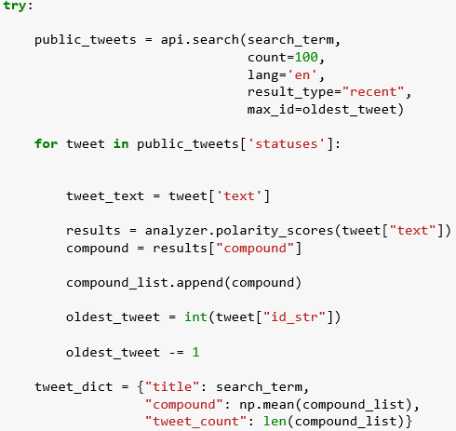
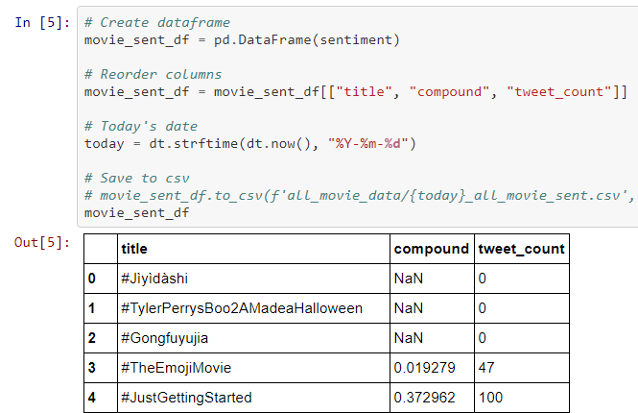

Code: Grabbing Tweet Data
Notes:
Now, we had to grab the twitter data. Due to limitations, for example, rate limit of 180 calls per 15 minutes, for each of the 153 movies in our csv file we produced beforehand, we pulled 100 tweets. We ran vader sentiment on the tweets and then calculated the mean compound value for each search term (movie hashtags). Here is the head of the dataframe. Finally, we merged this sentiment data dataframe to the movie data dataframe.

Slide 9
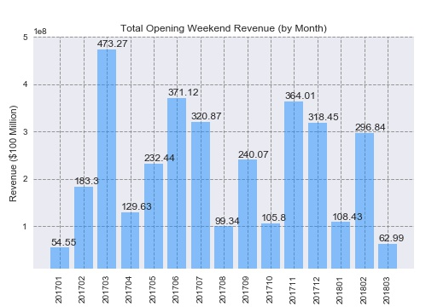
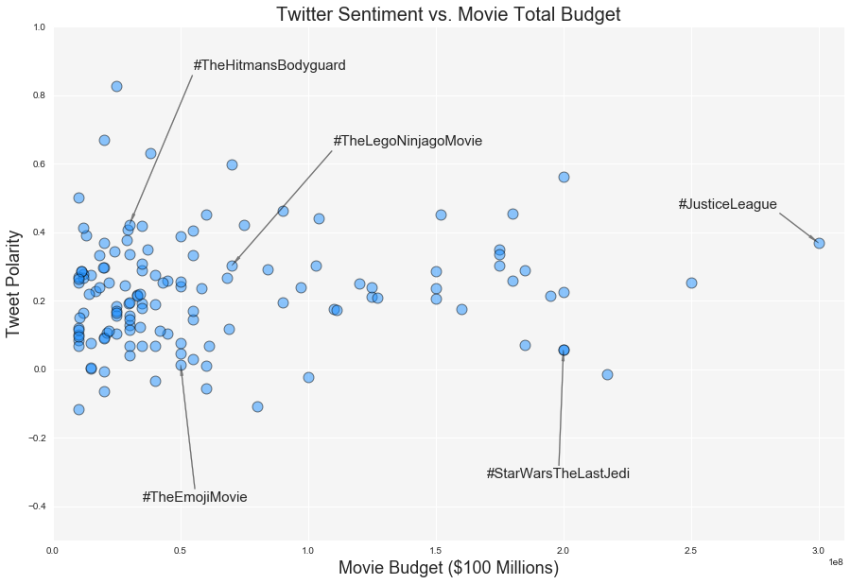
Analysis of Budget and Seasonality
Notes:
Shilpa:
Tweet polarity vs Movie Budget – Tweet polarity seemed to be unaffected by the budget of the movie. Some of the high budget movies like Justice League ($300 mil) and Star Wars – The Last Jedi ($200 mil) had a slightly positive polarity but so were the other movies with a budget < $100 mil. With regards to Budget, the tweet polarity outcome is not very conclusive.
Seasonality – The plot shows the Total of the weekend revenues of the movies released by month. It clearly shows that the revenue was much higher during summer break (Jun/July) and Winter break (Nov/Dec). Seasonality can be another factor affecting how well a movie does at the box office. The March ‘17 bar shows high earnings also during the spring break when Beauty and the Beast came out last year.

Slide 10
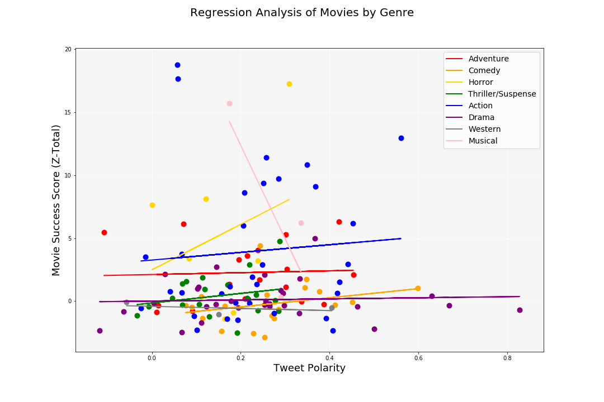
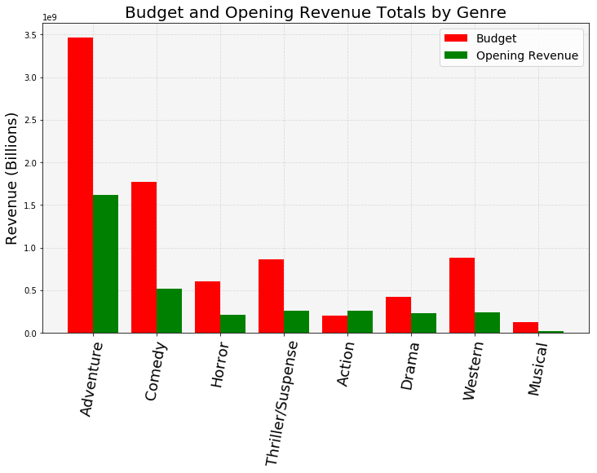
Genre: Opening Revenue and Success
Notes:
We also wanted to do a bit of an analysis based on movies and genre. We found that overall, a lot of money is spent on Adventure movies and this also makes up a bulk of the revenue. Next, we ran a regression of the movie tweet compound average polarity with the movie success score per genre. From this we found that based on tweet polarity, the genre with the best positive correlation was horror, followed by Action. The worst movies were musicals which had a strong negative correlation.

Slide 11
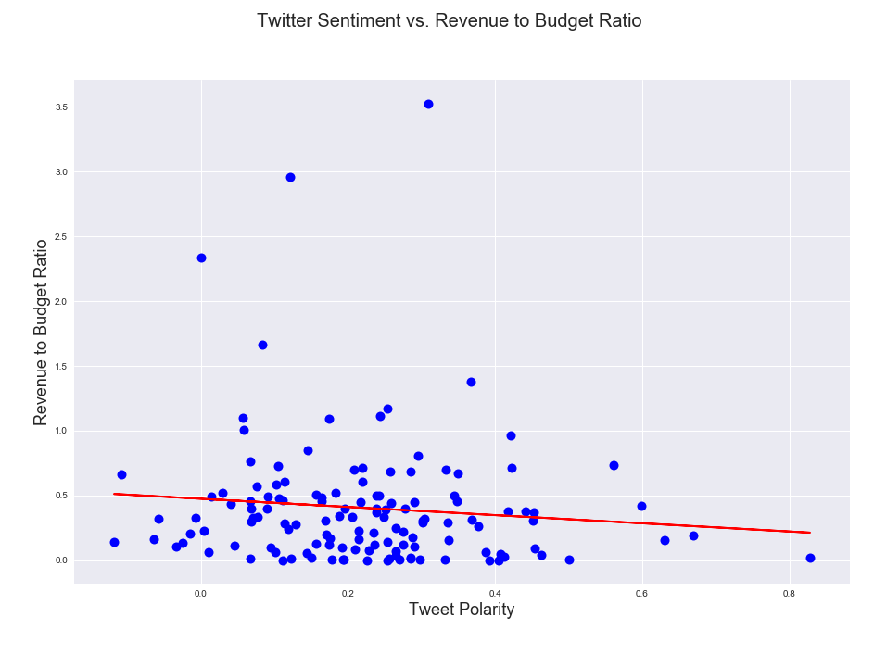
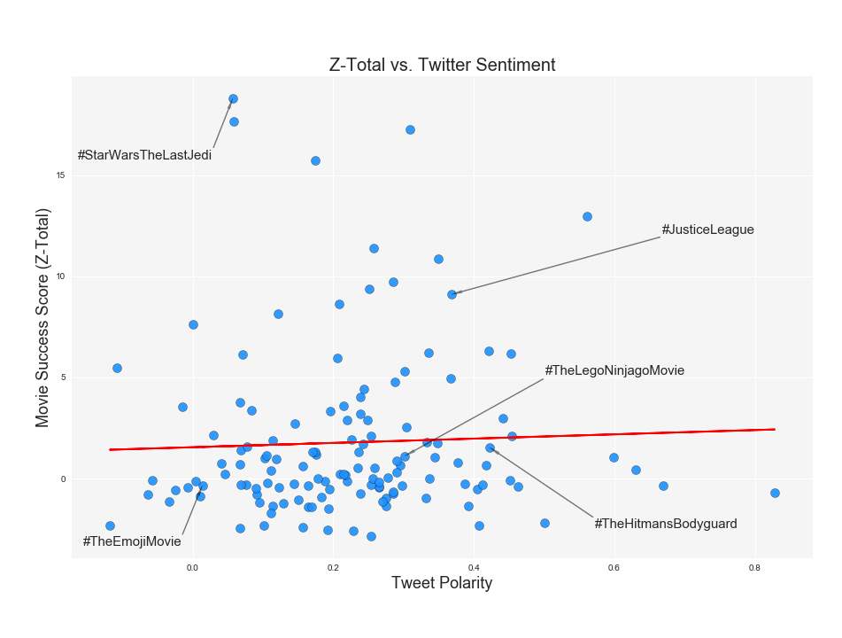
Regression: Open to Budget & Success
Notes:
Shilpa:
Twitter sentiment vs Revenue/Budget ratio: We ran a regression of the movie compound tweet polarity with the Ratio of Budget vs Opening weekend revenue. Ratio was considered just to be fair to the low budget movies. This plot looks pretty much inconclusive. From this we can see that, the earnings ratio was consistent even with lower polarity. Even with a high polarity, the ratio still remained low.
Twitter Sentiment vs Z-Total: From this we can see that there’s a very slight correlation between the polarity and the success score. The success score was calculated considering the z-scores of the Budget/Rev ration, rating, budget and the opening weekend revenue (All the factors that contribute to a movie’s success). Some movies like Star Wars did extremely well with a very high success score in spite of lower tweet polarity. Whereas movies like Hitman’s Bodyguard weren’t really successful in spite of higher tweet polarity.

Slide 12
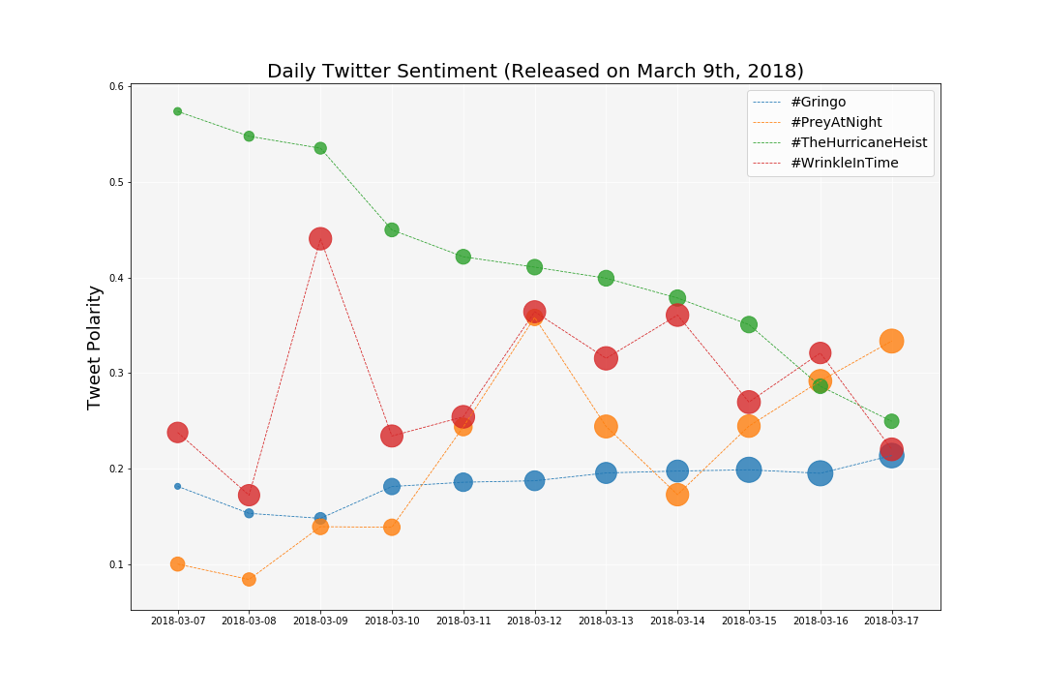
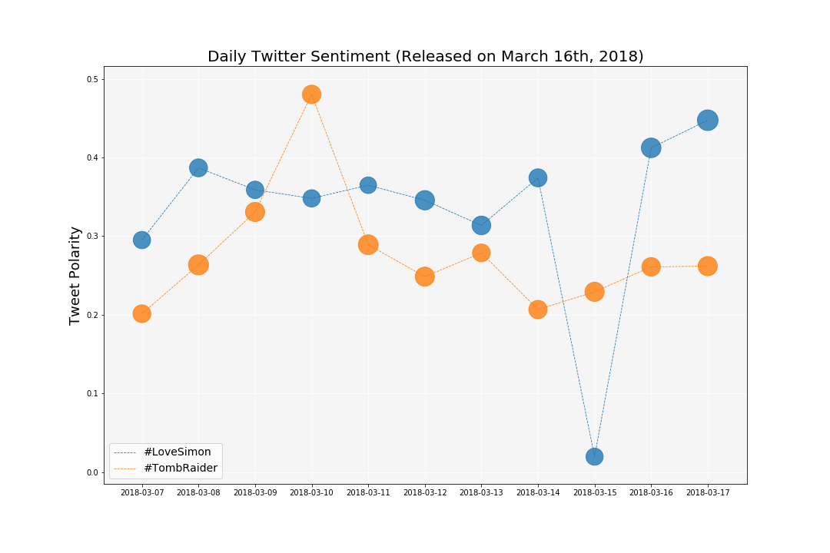
Daily Trends For Upcoming Movies
Notes:
We also looked at daily sentiment for movies released in the past week and a half and upcoming movies. On the left are 4 movies that released on the 9th. The marker size represents the number of tweet counts, so you can see whether or not a movie increased in buzz after the release or decreased. A Wrinkle in Time showed a massive positive spike in twitter sentiment the day before release, however, dropped on the day of. But then regained it’s positive sentiment. For the Hurricane Heist in green, tweet sentiment was really positive, but has been declining ever since release. And one can predict that this movie may not do well. On the right are two movies released on thet 16th, last Friday. Both movies had decent buzz. Love Simon, in blue, had a major dip two days before release for some reason.

Slide 13
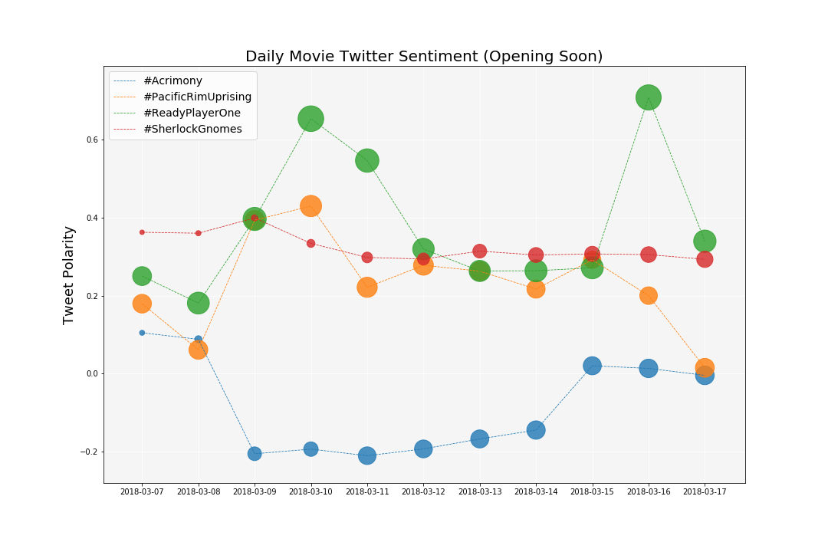
Daily Trends For Upcoming Movies
Notes:
And here are upcoming movies. Ready Player One, in green, shows high positive sentiment.

Slide 14
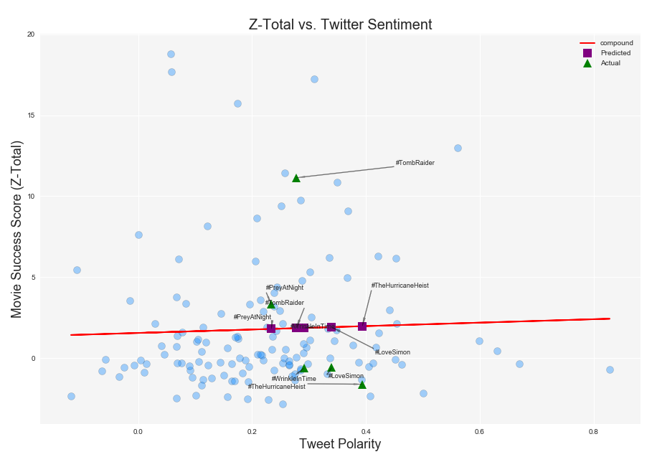
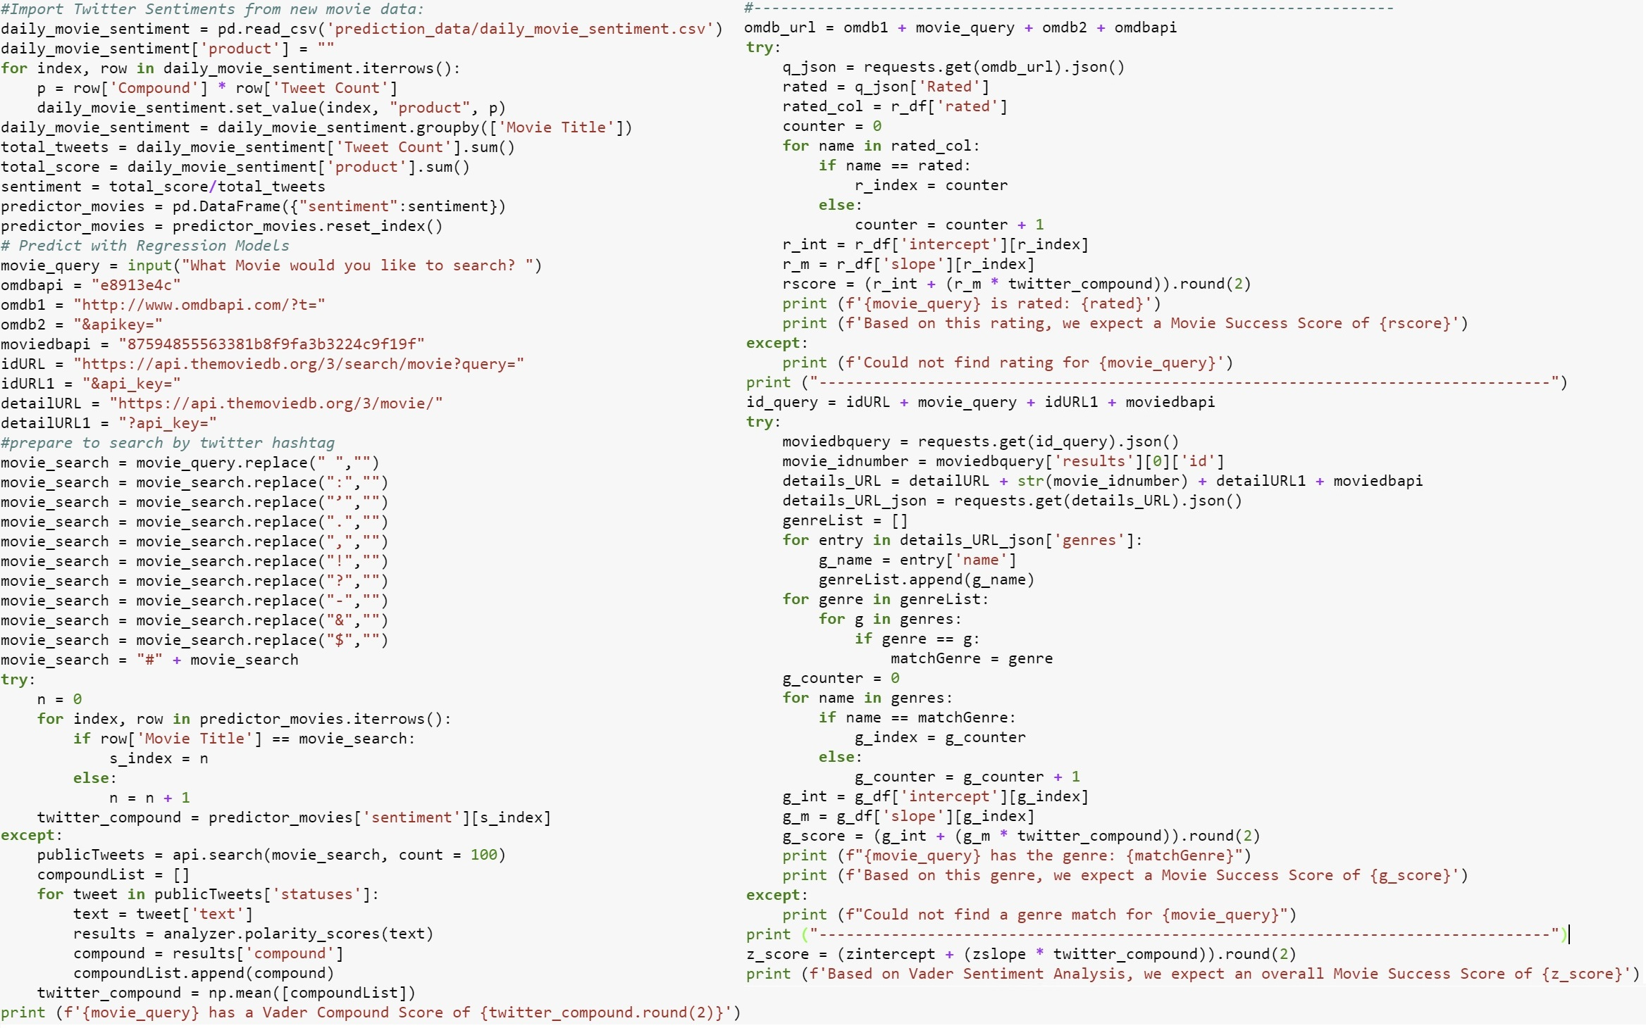
Predictions
Notes:
We were also able to run predictions based on our overall regression model. While the model is supposed to be run prospectively, it does work movies in the past. We graphed the last weekend movies based solely on our model. The purple squares represent what our model predicts as the movie success score, while the green triangles represent the actual movie success score of the same movies based on their actual revenues, ratings, and budgets. Lastly, we have built in code that will allow you to enter any movie that you want to search, we will search for twitter for the recent twitter sentiment and then use that sentiment to predict score based on genre, rating and our overall regression model.
[May want to run the code a couple of times.]

Slide 15
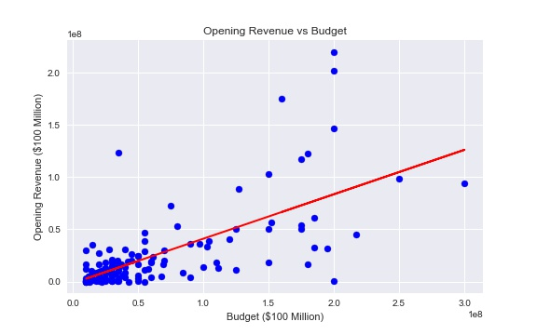
Movie Opening Revenue and Budget
Notes:
We were also able to run predictions based on our overall regression model. While the model is supposed to be run prospectively, it does work movies in the past. We graphed the last weekend movies based solely on our model. The purple squares represent what our model predicts as the movie success score, while the green triangles represent the actual movie success score of the same movies based on their actual revenues, ratings, and budgets. Lastly, we have built in code that will allow you to enter any movie that you want to search, we will search for twitter for the recent twitter sentiment and then use that sentiment to predict score based on genre, rating and our overall regression model.
[May want to run the code a couple of times.]

Slide 16
Summary
Findings & Challenges
Twitter Limitations
Limited search window (only 7 day history available)
Rate limits
Hashtags consistency (#BlackPanther vs #BlackPantherTheMovie)
Retweets
Vader Limitations
Movie title and keywords (Horrible Bosses, Happy Gilmore, Thank You For Your Service)
Neutral connotation is too wide (-0.5 to 0.5)
Final Findings
Despite challenges regression analysis of sentiment and success score have slight positive correlation
Seasonality of release date appear to favor movie revenue generation (opening weekend)
Genre: Action and Horror movie tend to perform well in both revenue and success score
Twitter has many variables to consider in order to determine if it can accurately predict box office success

